Slide 1

AUTO-WT TOOL
Team: Naveen Krishna k v
USN: 1SU19CI014
Department : Cloud Technology and Information Security
Guide: Mrs. Renisha

Slide 2
AGENDA
Abstract
Introduction
Literature Survey
System Design Methodology
Gui & Codes
Conclusion
Reference

Slide 3
ABSTRACT
As Internet usage is rising day by day security has become a vital facet to the Internet world. Security of the website in today's world is very important. We are introducing a solution to test web application vulnerability for SQL injection, XSS scripting by running automating script. It includes 3 types of SQL injection such as union based, error based and blind SQLi alongside XSS(cross site scripting). Project aims to reduce human effort in testing these attack against website and also saves time for users.

Slide 4

INTRODUCTION
DOMAIN
Cybersecurity is the protection to
defend internet-connected devices
and services from malicious
attacks by hackers, spammers, and
cybercriminals. The practice is used
by companies to protect against
phishing schemes, ransomware
attack, identity theft, data breaches, and financial losses.

Slide 5
PROBLEM STATEMENT
SQL injection attacks allow attackers to spoof identity, tamper with existing data, cause repudiation issues, allow the complete disclosure of all data on the system, destroy the data or make it otherwise unavailable, and become administrators of the database server.
Cross-site Scripting (XSS) is a client-side code injection attack. The attacker aims to execute malicious scripts in a web browser of the victim by including malicious code in a legitimate web page or web application
We are bringing a solution that automate these attack so that we can easily test weather these vulnerabilities are existing or not.

Slide 6
TECHNOLOGY
Hardware Requirements: Modern Operating System: Windows 7 or 10, x86 64-bit CPU (Intel / AMD architecture, 4 GB RAM, 5 GB free disk space
Front end we use Qt designer, Qt Designer is the Qt tool for designing and building graphical user interfaces (GUIs) with Qt Widgets.
This system is completely dependent on python programming, Python is a high-level, general-purpose programming language. It supports multiple programming paradigms, including structured, object-oriented and functional programming.
In this tool there is no data stored or retrieved, hence no database is involved.

Slide 7
LITERATURE SURVEY
REVIEW
A SQL injection attack consists of insertion or “injection” of a SQL query via the input data from the client to the application.
Cross-Site Scripting (XSS) attacks are type of injection problems in modern Web applications that can be exploited by injecting JavaScript code

Slide 8
EXISTING SYSTEMS
A command-line interpreter or command-line processor uses a command-line interface (CLI) to receive commands from a user in the form of lines of text.
It uses python module named __future__ module, is a built-in module in Python that is used to inherit new features that will be available in the new Python versions..
User has to familiarize with different commands in order to retrieve different kind of information’s
It consists of different types of SQL injection & Blind SQL injection

Slide 9
PROPOSED SYSTEM-PLANING
Graphical user interface:- a computer program that enables a person to communicate with a computer through the use of symbols, visual metaphors, and pointing devices
Python is a general-purpose, versatile, and powerful programming language. It’s a great first language because Python code is concise and easy to read.
Our system consists SQL injection error based, union based and blind SQLi attacks along with XSS scripting.

Slide 10
MOTIVATION TO IMPLEMENT
The class of vulnerabilities known as SQL injection and XSS scripting continues to present an extremely high risk in the current network threat landscape. Exploitation of these vulnerabilities has been implicated in many recent high-profile intrusions.
Although there is an abundance of good literature about how to prevent SQL injection vulnerabilities or XSS, still these attack continues to appear.
So we introduce a system which allow users to test the website instead of just giving prevention mechanisms that might leave a chance that vulnerability to exist.

Slide 11
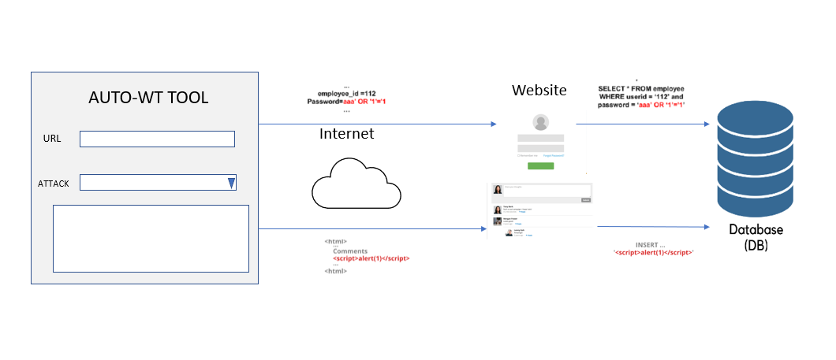
SYSTEM DESIGN METHODOLOGY
SYSTEM ARCHITECTURE DIAGRAM

Slide 12
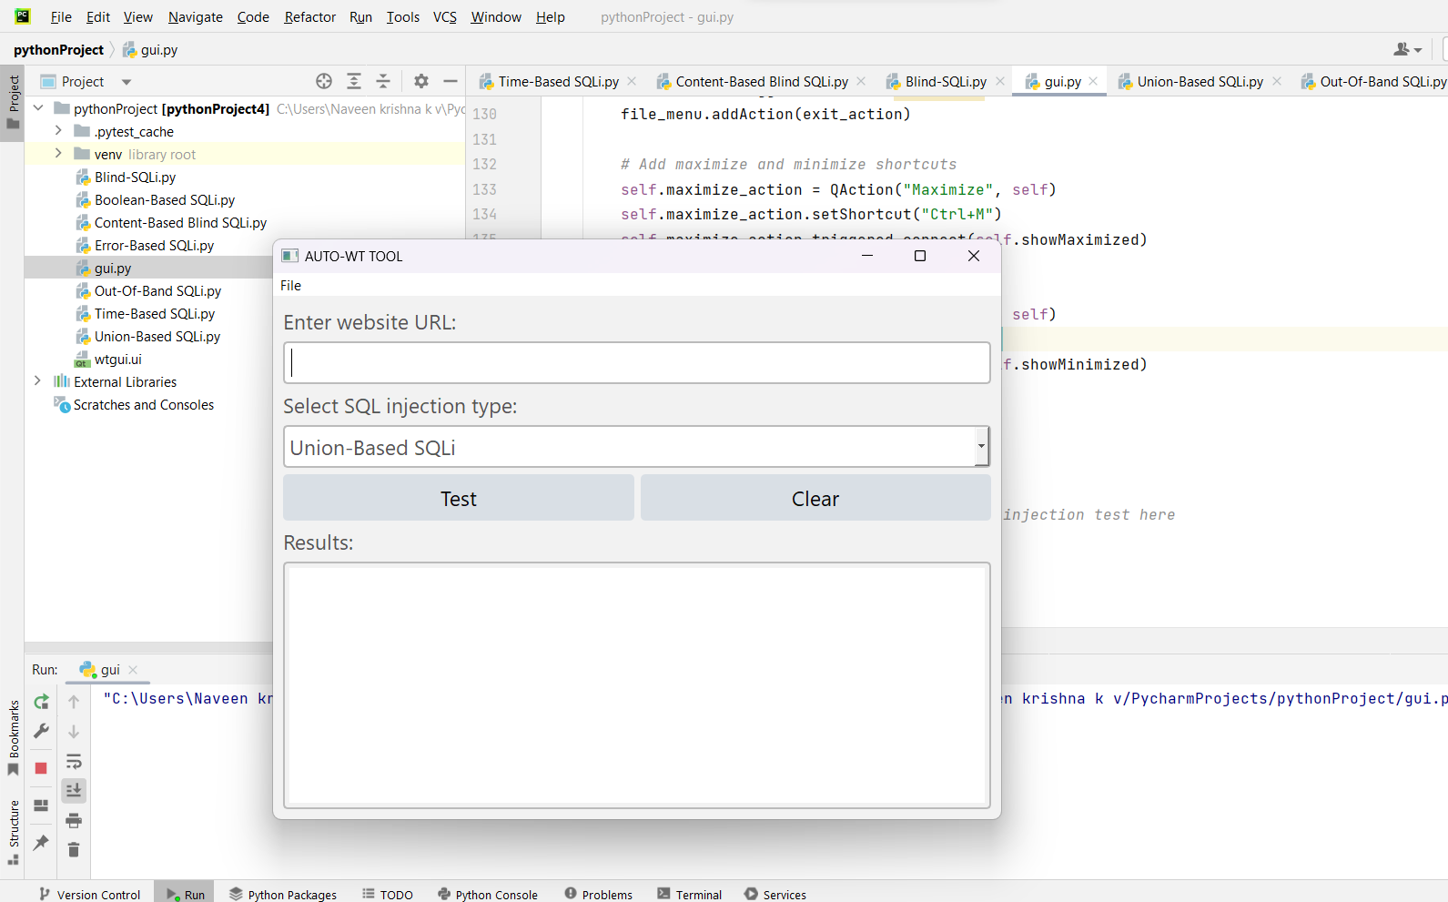
GUI & CODES

Slide 13
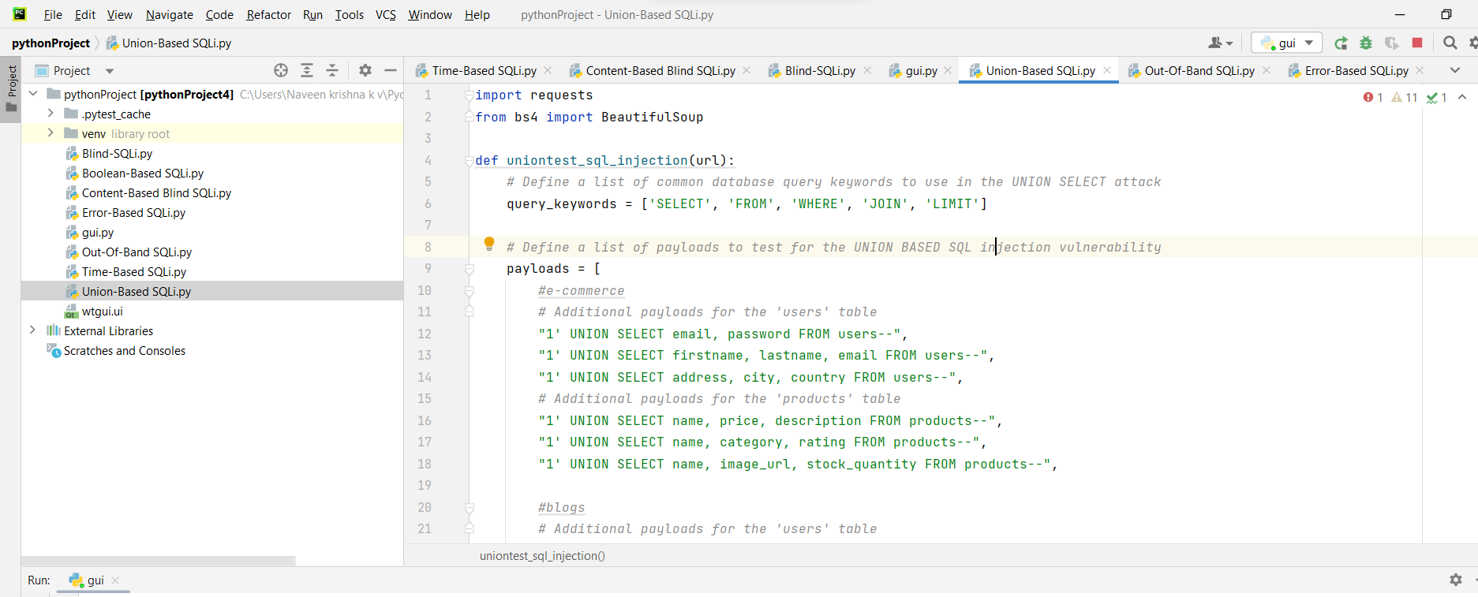
Union SQL-injection

Slide 14
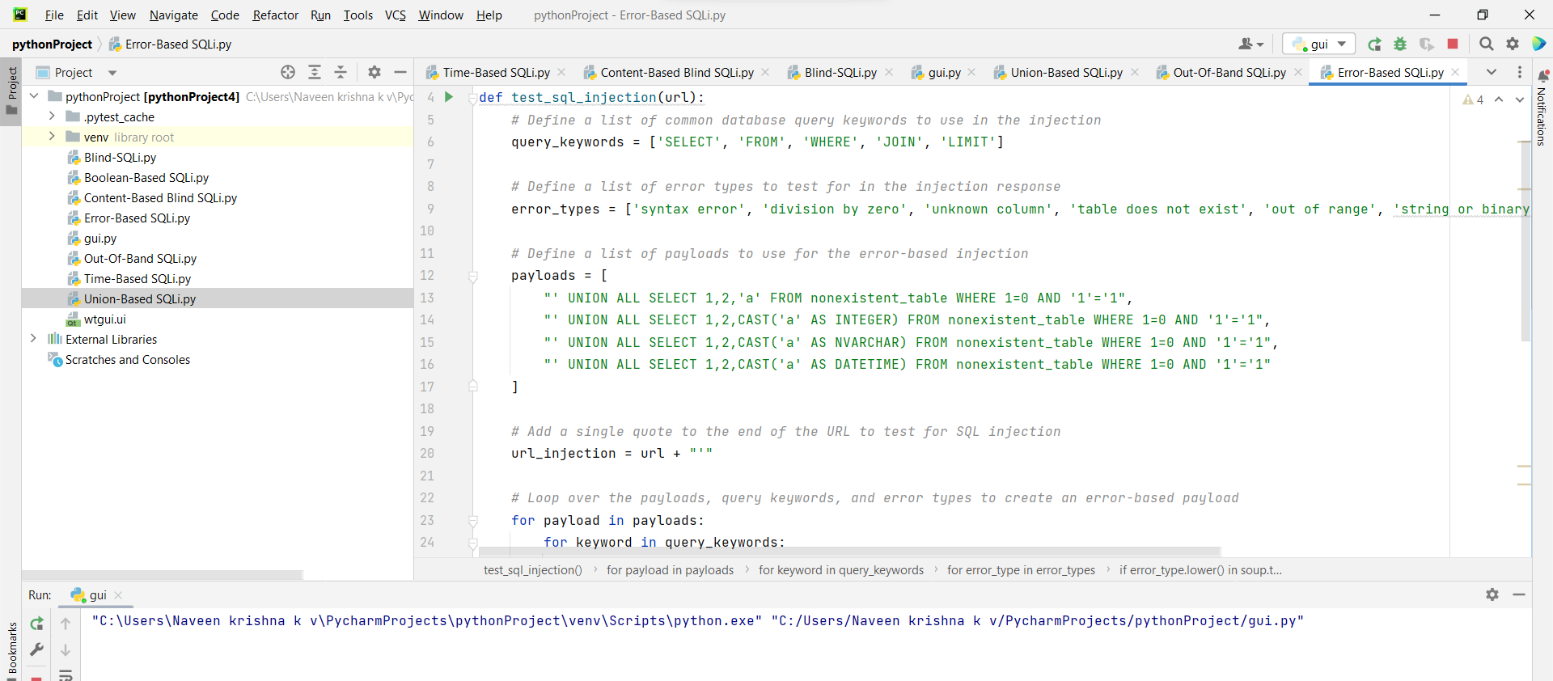
ERROR based sql-injection

Slide 15
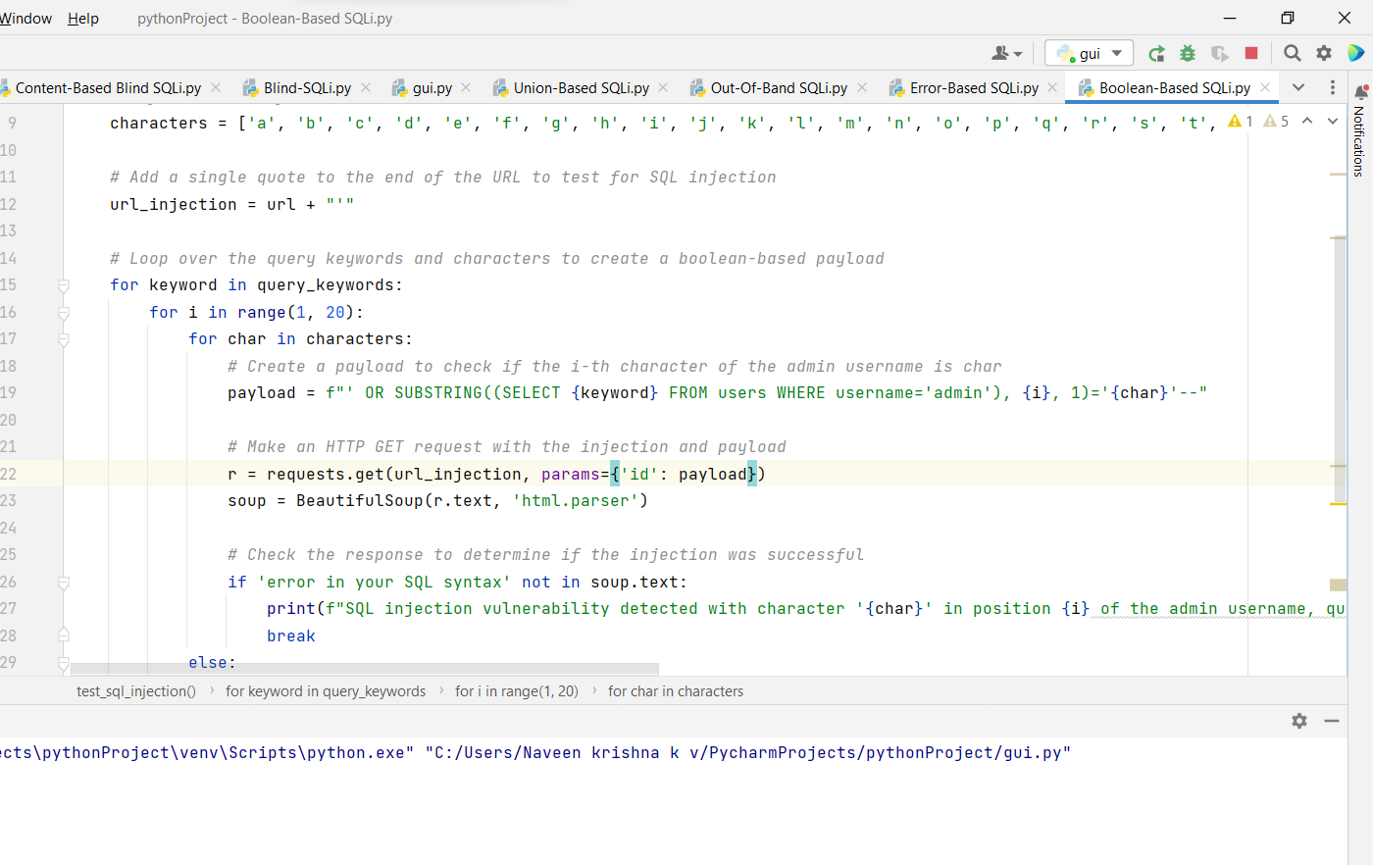
BOOLEAN BASED SQLi

Slide 16
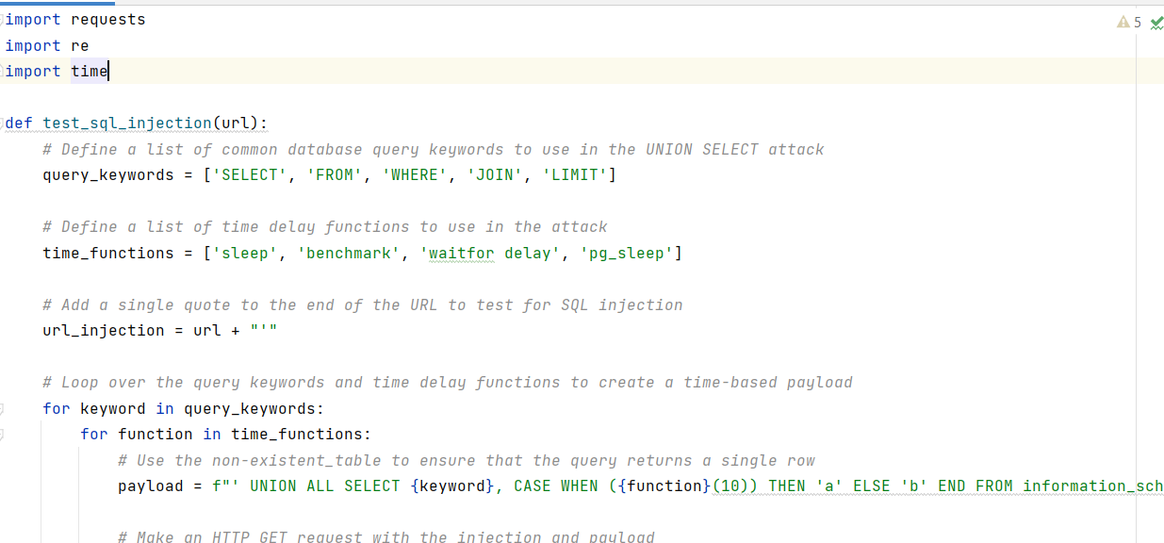
TIME-BASED SQLi

Slide 17
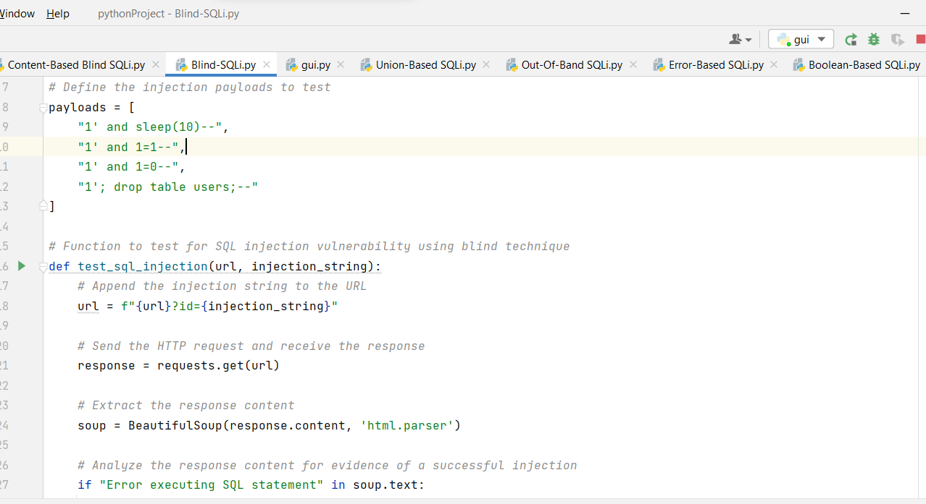
BLIND SQLi

Slide 18
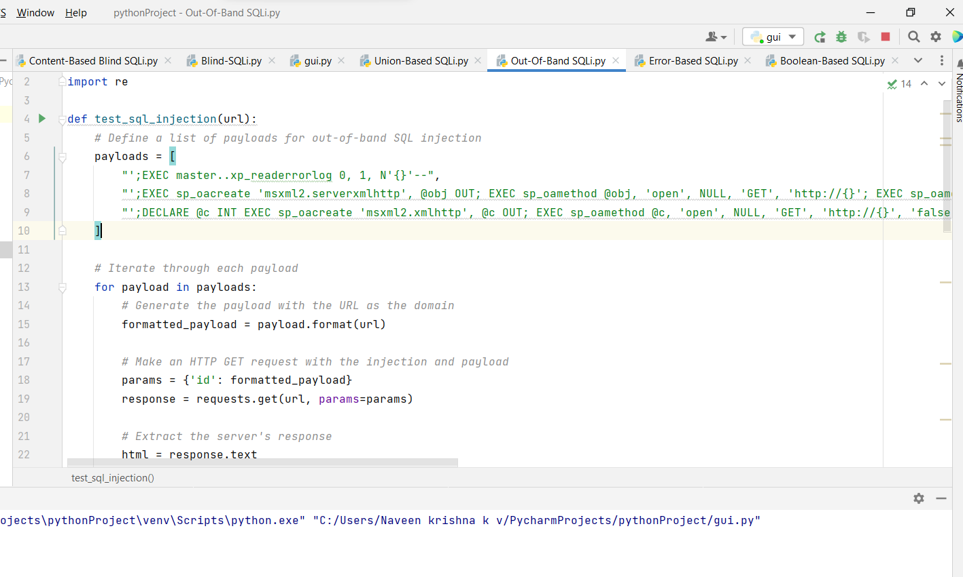
OUT-OF-BAND sqli

Slide 19
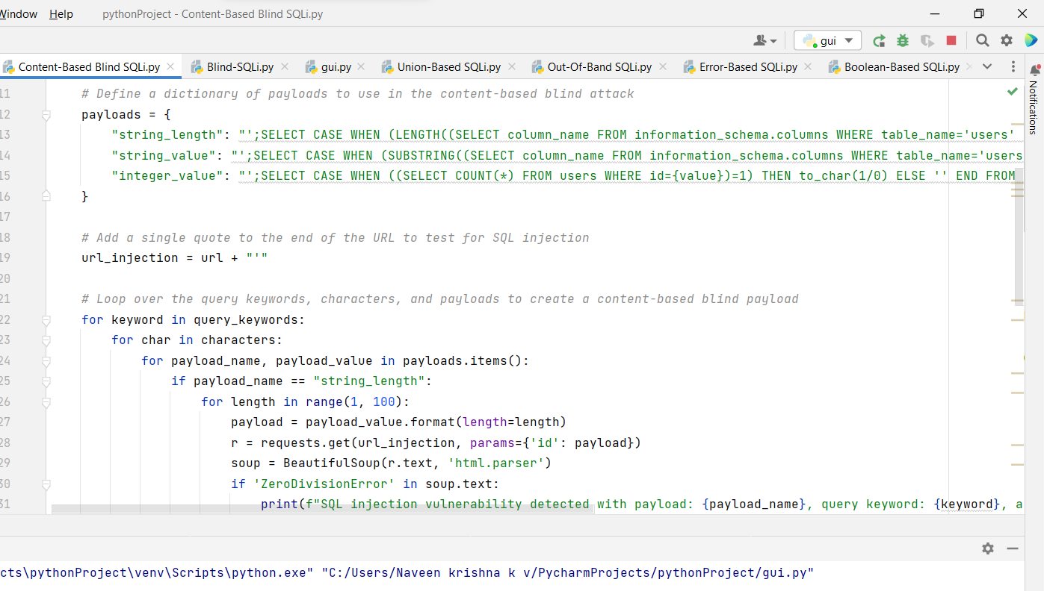
CONTENT-BASED SQLi

Slide 20
CONCLUSION
In this project, we have demonstrated a method for testing web applications for SQL injection and xss scripting vulnerabilities that closely mimics those that attackers use in the wild.
Our system will Eliminate the manually entering process with automation which allow users save time during executing these attacks and test there websites with ease.

Slide 21
REFERENCE
Research paper of already existing SQL attack tool https://wicksnet.wordpress.com/2014/09/30/sql-injection-using-sqlmap/
XSS Attack Detection Approach Based on Scripts Features Analysis: https://link.springer.com/chapter/10.1007/978-3-319-77712-2_19
SQLmap project http://sqlmap.org/
PortsSwigger to test SQLi https://portswigger.net/web-security/sql-injection
Executing Blind SQL injection https://youtu.be/F8fjsJBJK4w
Practical Identification of SQL Injection Vulnerabilities: https://www.cisa.gov/uscert/sites/default/files/publications/Practical-SQLi-Identification.pdf
Testing and Comparing Web Vulnerability Scanning Tools for SQL Injection and XSS Attacks: https://ieeexplore.ieee.org/abstract/document/4459684

